Slide 1

Advanced Multi-Robot and UAV Navigation with Deep Reinforcement Learning
A Comparative Study
Shivansh Vishwakarma

Slide 2
Introduction
- Importance of navigation in dynamic environments for robots and UAVs.
- Brief introduction to DRL.
- Papers overview:
- 'Cooperative Multi-Robot Navigation in Dynamic Environment with Deep Reinforcement Learning'
- 'Multi-Agent Deep Reinforcement Learning for UAVs Navigation in Unknown Complex Environment'

Slide 3
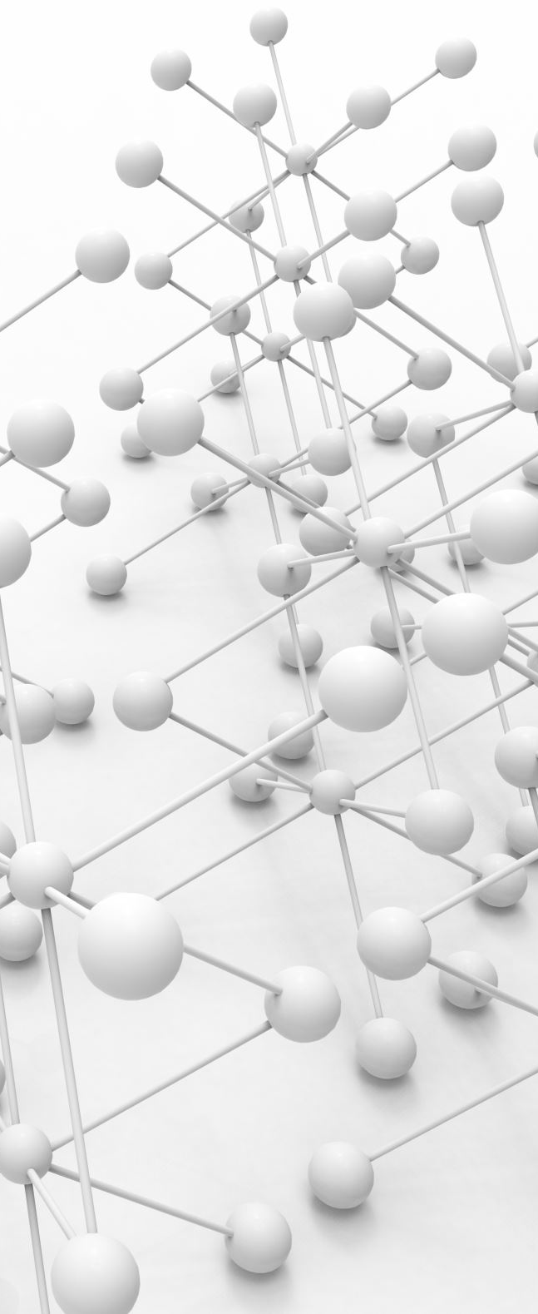
Cooperative Multi-Robot Navigation in Dynamic Environment with Deep Reinforcement Learning
Abstract: Addresses challenges in navigating dynamic environments with uncertainties and partial observability. Proposes a cooperative approach using DRL.

Slide 4

Contributions
The paper presents a novel Deep Reinforcement Learning (DRL) based navigation policy designed for multiple robots operating in dynamic environments. The main contributions include:
Shared and Updated Navigation Policy: Development of a shared navigation policy optimized for all robots in a dynamic environment.
Target Location Allocation Algorithm: A method to allocate target locations to robots to minimize total travel time.
Randomized Dynamics Parameters: Introduction of randomized dynamics parameters during training to improve real-world adaptability.
Performance Evaluation: Comprehensive simulation and real-world experiments demonstrating the superior performance of the proposed policy.

Slide 5
Problems Addressed
The primary problem addressed is the efficient and collision-free navigation of multiple robots in a dynamic environment. Specifically, the goal is to develop a navigation policy that minimizes the travel time for robots to reach their target positions while avoiding collisions with other robots and obstacles

Slide 6
Methods
1. Deep Reinforcement Learning Framework: Utilizes an actor-critic model where each robot selects actions based on a shared stochastic policy.
State Space: Includes the current robot's state, other robots' states, obstacles’ states, and target positions.
Action Space: Consists of continuous actions for transitional and rotational velocities.
Reward Design: Combines rewards for reaching target locations and penalties for collisions​​.
2. Actor-Critic Model:
Actor: A neural network with three hidden layers to map states to actions.
Critic: A neural network with two hidden layers to estimate the value of actions taken at specific states​​.
3. Dynamics Randomization: Incorporates Gaussian noise into various dynamics parameters during training to simulate real-world uncertainties and enhance policy robustness​

Slide 7
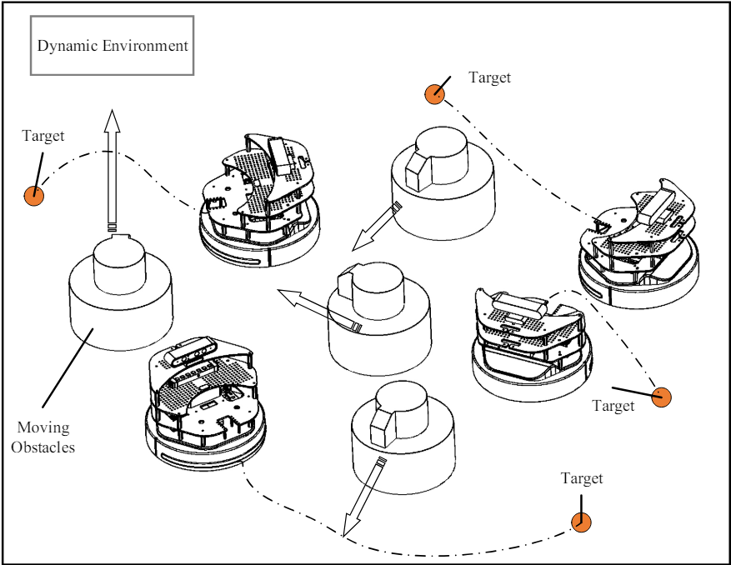
Multi-robot navigation in dynamic environment

Slide 8
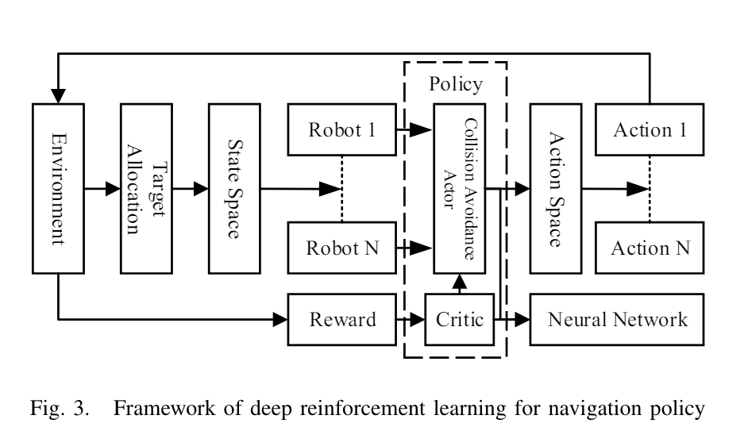


Slide 9
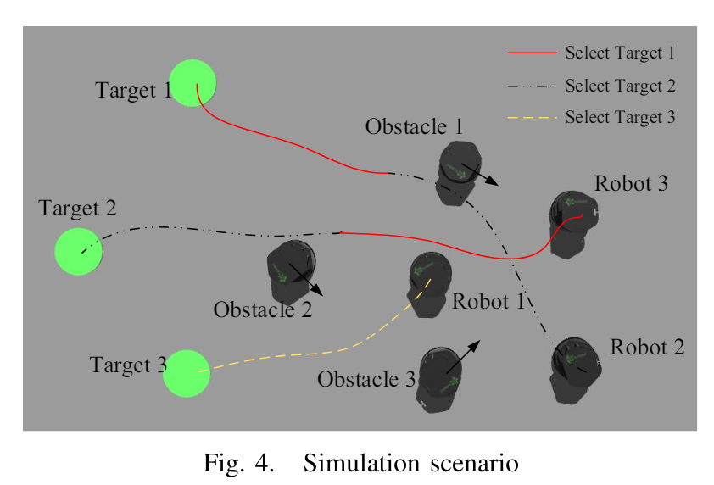


Slide 10
Environment
The environment for training and testing the navigation policy consists of:
Simulated Environment: Used for initial training with precise control over robot dynamics.
Real World: Used for testing and validating the policy, where real-world uncertainties and sensor noise are present.

Slide 11
Results
The results from experiments demonstrate:
Simulation and Real-World Performance: The proposed policy
shows high success rates and reduced extra travel time in both
simulated and real-world environments compared to baseline
methods.
Effectiveness of Randomized Dynamics: The deterioration in
performance when transitioning from simulation to the real world is
significantly mitigated using randomized dynamics parameters.
Quantitative Improvements: The target location allocation
algorithm saves about 14.32% of extra travel time compared to
other methods. The performance deterioration in real-world
applications is reduced to a 1.62% decrease in success rate and a
9.76% increase in travel time​​.

Slide 12
Limitations
1. Complex Dynamic Environments: The current approach may not
fully address more complex dynamic environments with higher
levels of uncertainty and more intricate obstacle arrangements.
2. Dependency on External Sensors: The approach still relies on
numerous external sensors for accurate state estimation, which
might not be feasible in all real-world scenarios.
3. Training Time: The need for extensive training time due to the use
of simulated environments and the complexity of the DRL model.

Slide 13
Multi-Agent Deep Reinforcement Learning for UAVs Navigation in Unknown Complex Environment
: Focuses on UAV navigation in unknown and complex environments using multi-agent DRL.

Slide 14
Contributions
The paper presents several key contributions to the field of multi-agent UAV navigation:
Modeling the Navigation Problem: The paper models the navigation of multiple UAVs in an unknown and complex environment as a decentralized partially observable Markov decision process (Dec-POMDP). A centralized training and decentralized execution multi-agent deep reinforcement learning (MADRL) algorithm is proposed to solve this problem. This approach allows each UAV to consider the policies of other UAVs during training and to operate independently during execution without communication.
Introduction of MARDPG Algorithm: The paper proposes the Multi-Agent Recurrent Deterministic Policy Gradient (MARDPG) algorithm. This algorithm integrates recurrent neural networks into MADRL to capture latent state information, which is particularly beneficial for navigation decisions in environments where UAVs have limited field of view.
Enhanced Training Methods: To expedite the training process, the paper designs comprehensive state and reward information using domain knowledge. The use of distance information from rangefinders helps bridge the gap between the simulated environment and real-world applications. The proposed strategy is experimentally validated to extend easily to other unseen complex environments

Slide 15
Problems Addressed
The primary problem addressed in this paper is the navigation and collision avoidance of multiple UAVs in an unknown and complex environment. This problem is challenging due to the high dimensionality and uncertainty of the environment, limited field of view of UAVs, and the need for each UAV to operate independently without real-time communication with other UAVs

Slide 16
Methods
The methods used in the paper include:
Dec-POMDP Framework: The navigation problem is framed as a Dec-POMDP, allowing for a formal definition of the environment and agent interactions.
Centralized Training, Decentralized Execution: During the training phase, each UAV has access to global information, but during execution, each UAV operates independently based on local observations. This method ensures that UAVs can operate without real-time communication, which is often impractical in real-world scenarios.
MARDPG Algorithm: The MARDPG algorithm is used for training. This algorithm incorporates recurrent neural networks to process historical observations and improve decision-making based on the estimated policies of other agents.
Domain Knowledge Integration: The training process is enhanced with domain-specific state and reward information, which improves the learning efficiency and effectiveness of the algorithm.
Rangefinder Data Utilization: Distance information collected by rangefinders is used to enhance the training process, making the simulation environment more reflective of real-world conditions.

Slide 17
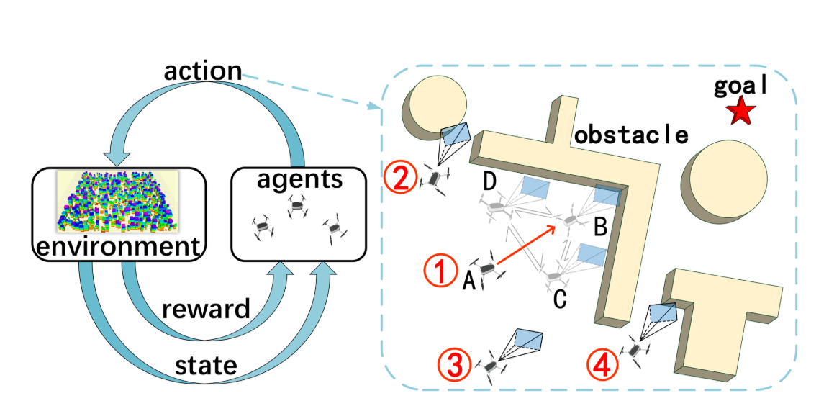
Schematic diagram of multi-UAV navigation observability in complex environment. The left side shows the reinforcement learning interaction process, and the right side shows the navigation behavior of multi-UAV in the environment. The blue cone in front of the UAV shows its perception range, and the red arrow indicates that the drone is encouraged to move towards the target.

Slide 18
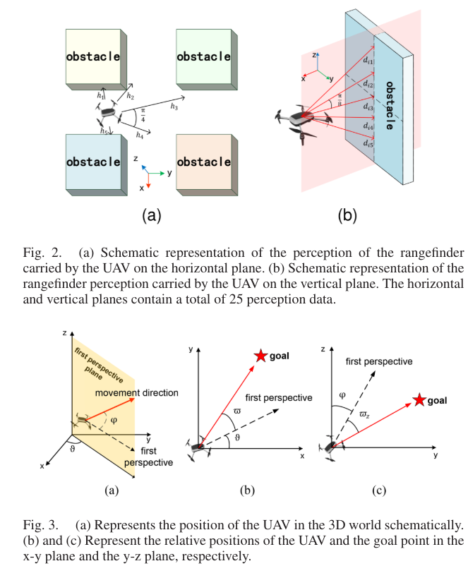



Slide 19
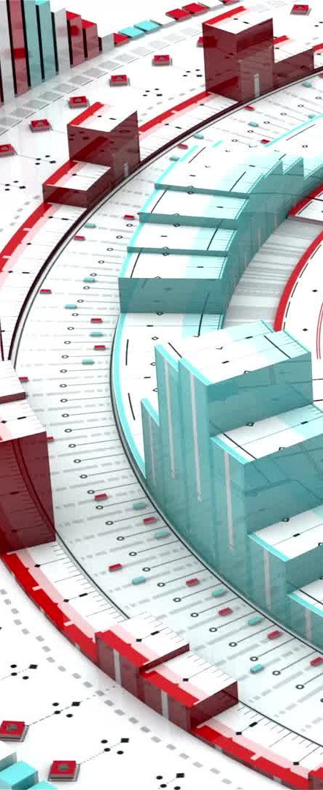
Environment
The environment used for the experiments is a simulated unknown and complex environment with obstacles and limited visibility. UAVs in this environment have a restricted field of view and need to rely on historical data and local observations to navigate effectively. The simulation environment is designed to closely mimic real-world conditions, including the use of distance information from rangefinders​

Slide 20
Results
The results of the experiments demonstrate that the proposed MADRL algorithm with the MARDPG method can effectively navigate multiple UAVs in an unknown and complex environment. The integration of recurrent neural networks and domain-specific state and reward information significantly improves the decision-making capabilities of the UAVs. The experimental validation shows that the strategy can be easily extended to other unseen environments, highlighting its robustness and adaptability​

Slide 21

Limitations
Some limitations identified in the paper include:
Scalability: The computational complexity of the centralized training phase can increase significantly with the number of UAVs and the complexity of the environment.
Communication Constraints: While the decentralized execution phase does not require real-time communication, the lack of communication can limit the ability of UAVs to coordinate in real-time, potentially leading to suboptimal navigation decisions in highly dynamic environments.
Real-World Validation: Although the simulation environment is designed to mimic real-world conditions, there is still a gap between simulation and real-world applications. The effectiveness of the proposed methods in actual real-world scenarios needs further validation

Slide 22
Comparative Analysis
- Methodologies:
- Paper 1: Cooperative multi-robot navigation.
- Paper 2: Multi-agent UAV navigation.
- DRL Frameworks:
- Paper 1: Actor-critic model.
- Paper 2: Specific DRL algorithms for UAVs.
- Key Contributions:
- Paper 1: Focus on real-world application with dynamics randomization.
- Paper 2: Focus on collaboration in unknown environments.

Slide 23
Applications and Implications
- Real-world applications:
- Surveillance
- Rescue missions
- Autonomous exploration
- Potential impact on industries and future research directions.

Slide 24

Conclusion
- Key takeaways:
- Both papers contribute significantly to DRL in navigation.
- Paper 1 emphasizes cooperative multi-robot systems.
- Paper 2 focuses on collaborative UAV navigation.
- Future research directions:
- Enhancing DRL frameworks
- Broader real-world applications

